Slide 1
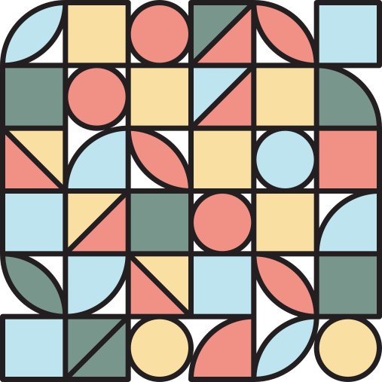
ANGLES
GRADE 4 MATHEMATICS

Slide 2
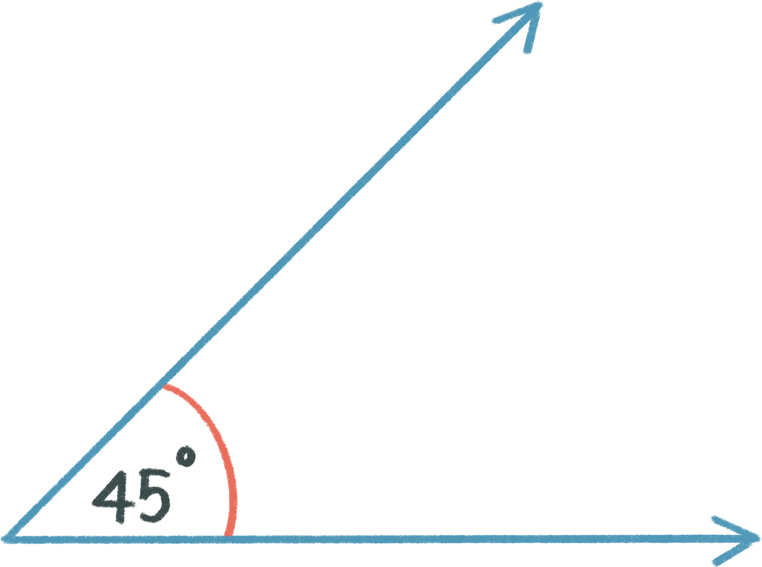
WHAT ARE ANGLES?
The space between two intersecting straight lines, at the point in which they meet.
straight line
degrees
The point where they meet is called the vertex.
vertex
straight line
Angles are measured in degrees.

Slide 3
straight line
degrees
vertex
straight line

Slide 4
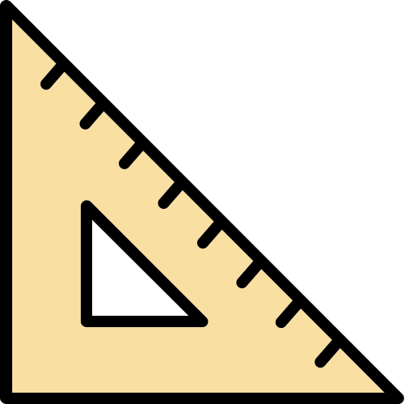
TYPES OF ANGLES
smallest
Acute (>0, <90 degrees)
Right (90 degrees)
Obtuse (>90, <180 degrees)
Straight (180 degrees)
Reflex (>180, <360 degrees)
largest
Revolution (360 degrees)

Slide 5
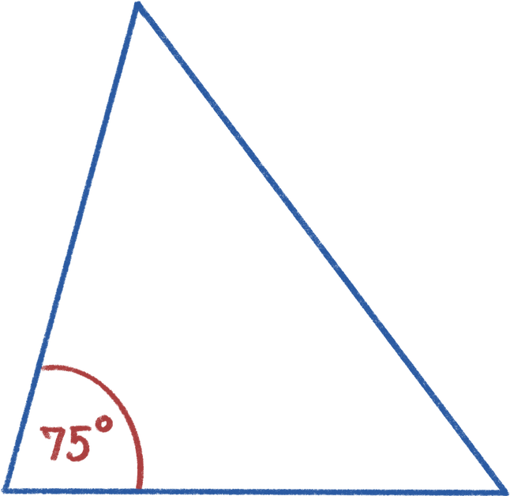
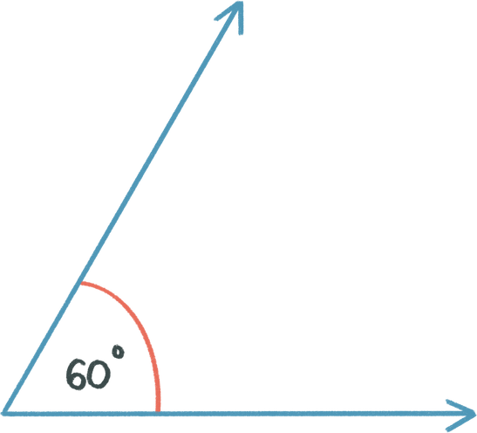
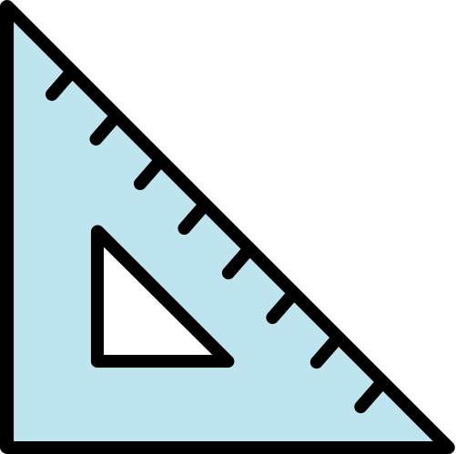
ACUTE ANGLES
The internal measurement of two straight lines, where the angle measures more than 0 but less than 90.

Slide 6
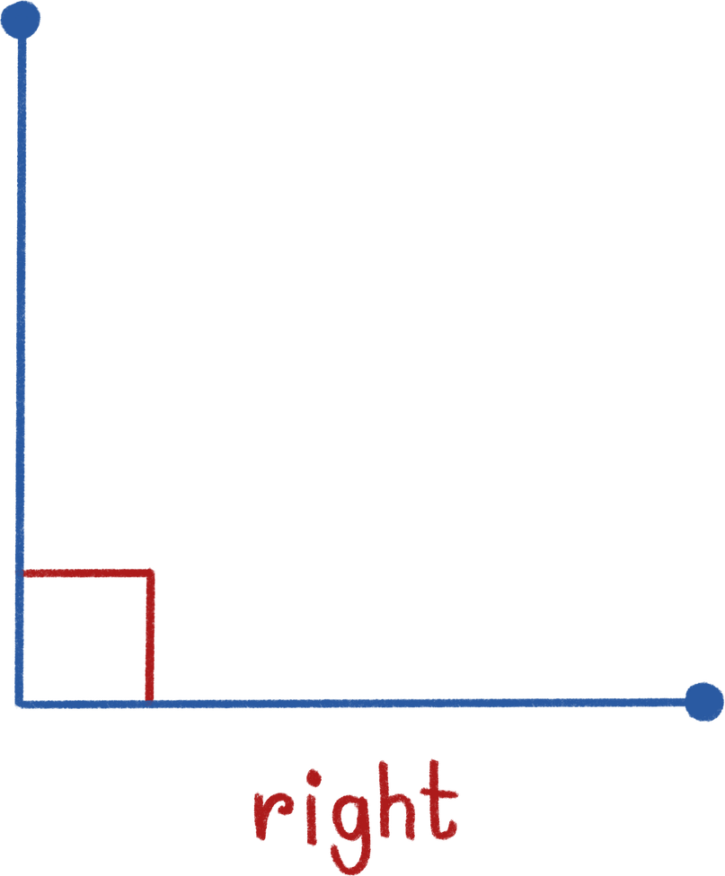
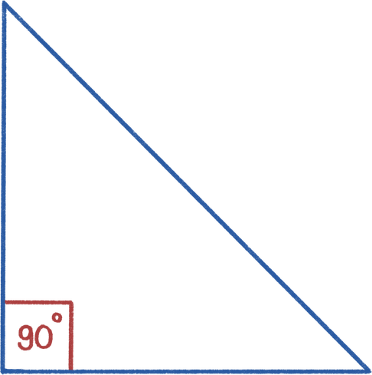
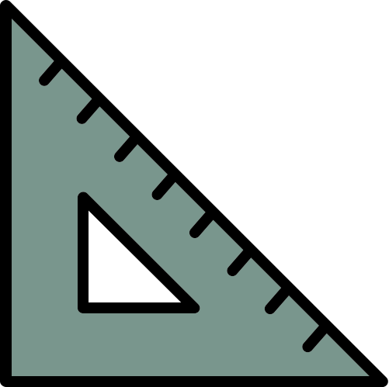
RIGHT ANGLES
A right angle is equal to 90

Slide 7
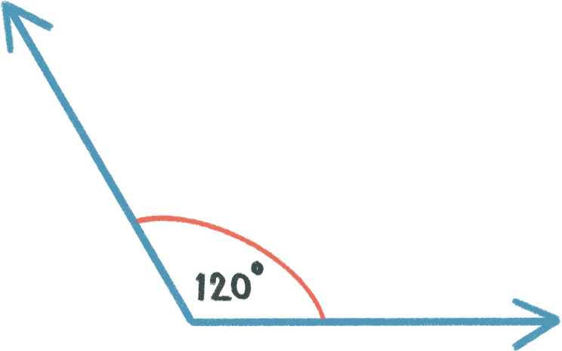
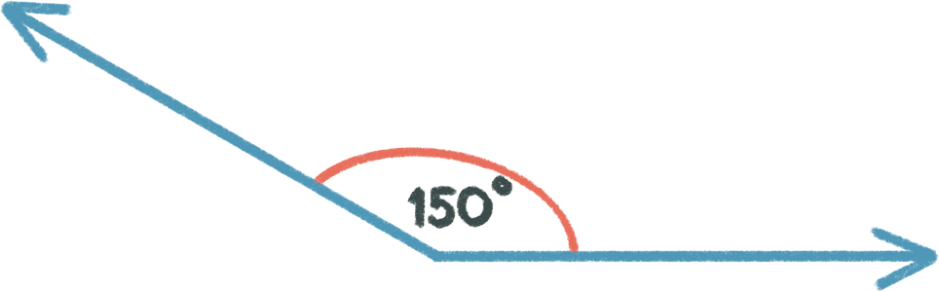

OBTUSE ANGLES
The internal measurement of two straight lines, where the angle measures more than 90 but less than 180.

Slide 8
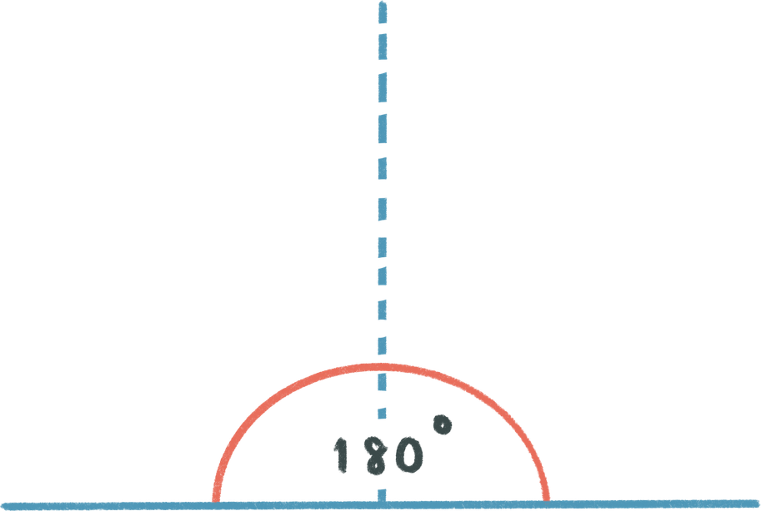
STRAIGHT ANGLES
A straight angle is equal to 180

Slide 9
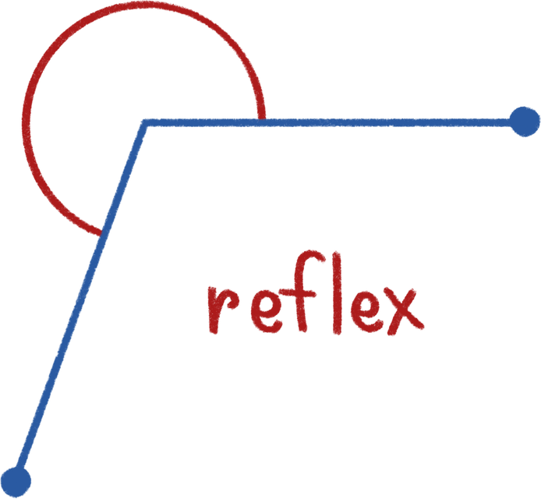
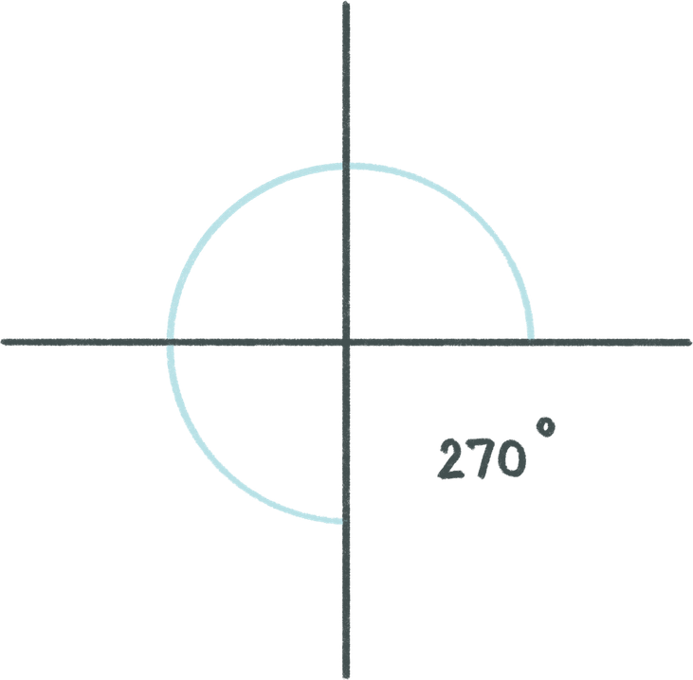
REFLEX ANGLES
The external measurement of two straight lines, where the angle measures more than 180 but less than 360.

Slide 10
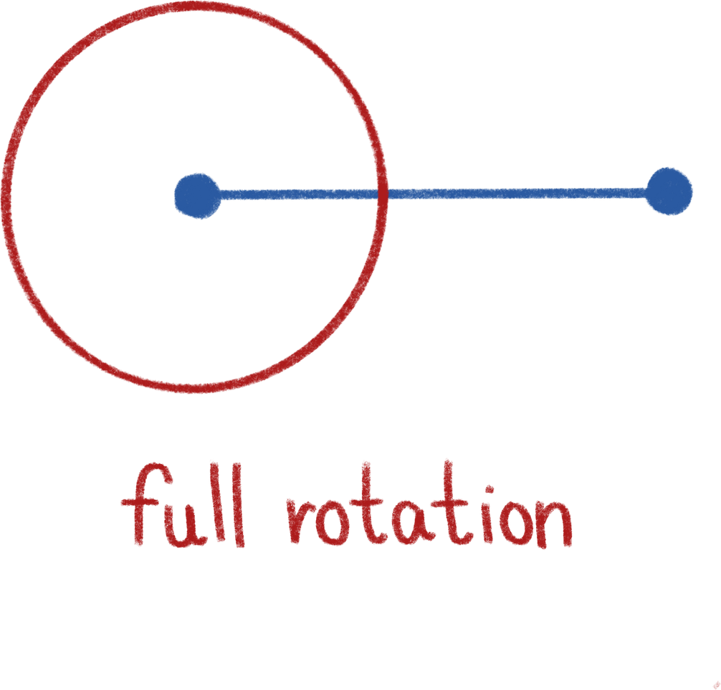
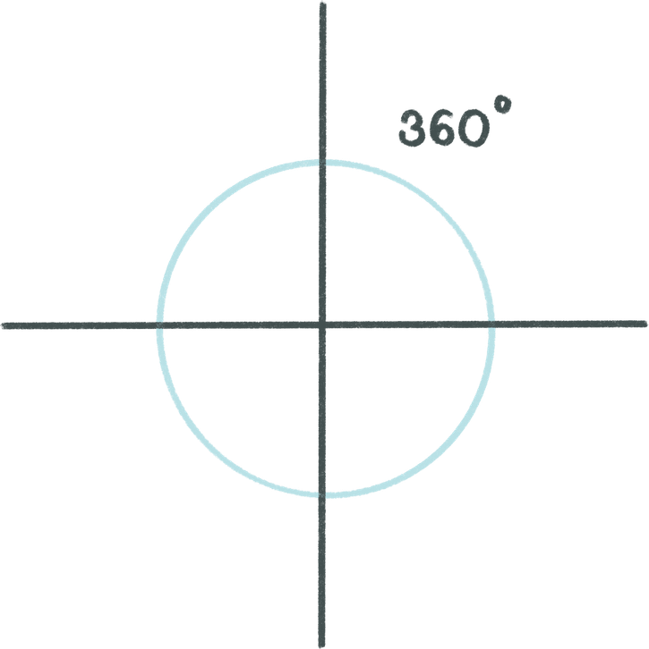

REVOLUTION ANGLES
A full rotation of 360

Slide 11

What types of angles can you see?

Slide 12
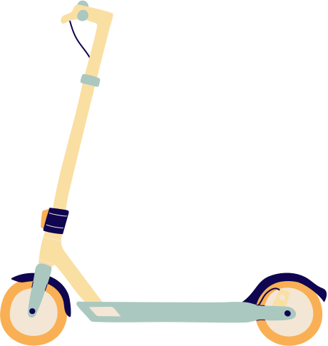
What types of angles can you see?

Slide 13
What types of angles can you see?

